Slide 1
Basic Concepts
Software Architecture
Lecture 3

Slide 2
What is Software Architecture?
Definition:
  A software system’s architecture is the set of principal design decisions about the system
Software architecture is the blueprint for a software system’s construction and evolution
Design decisions encompass every facet of the system under development
  Structure
  Behavior
  Interaction
  Non-functional properties

Slide 3
What is “Principal”?
“Principal” implies a degree of importance that grants a design decision “architectural status”
  It implies that not all design decisions are architectural
  That is, they do not necessarily impact a system’s architecture
How one defines “principal” will depend on what the stakeholders define as the system goals

Slide 4
Other Definitions of Software Architecture
Perry and Wolf
  Software Architecture = { Elements, Form, Rationale }
  what how why
Shaw and Garlan
  Software architecture [is a level of design that] involves
    the description of elements from which systems are built,
    interactions among those elements,
    patterns that guide their composition, and
    constraints on these patterns.
Kruchten
  Software architecture deals with the design and implementation of the high-level structure of software.
  Architecture deals with abstraction, decomposition, composition, style, and aesthetics.

Slide 5
Temporal Aspect
Design decisions are and unmade over a system’s lifetime
→ Architecture has a temporal aspect
At any given point in time the system has only one architecture
A system’s architecture will change over time

Slide 6
Prescriptive vs. Descriptive Architecture
A system’s prescriptive architecture captures the design decisions made prior to the system’s construction
  It is the as-conceived or as-intended architecture
A system’s descriptive architecture describes how the system has been built
  It is the as-implemented or as-realized architecture

Slide 7
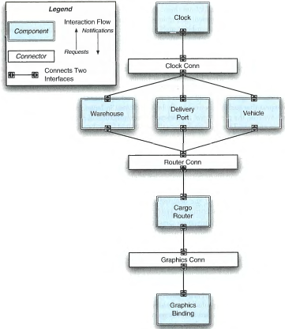
As-Designed vs. As-Implemented Architecture
Software Architecture: Foundations, Theory, and Practice; Richard N. Taylor, Nenad Medvidovic, and Eric M. Dashofy; © 2008 John Wiley & Sons, Inc. Reprinted with permission.

Slide 8
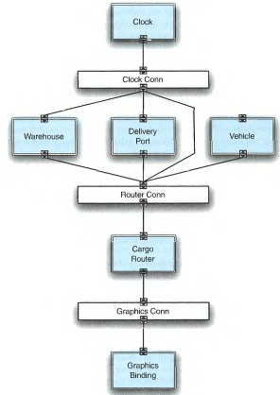

As-Designed vs. As-Implemented Architecture

Slide 9
As-Designed vs. As-Implemented Architecture
Which architecture is “correct”?
Are the two architectures consistent with
one another?
What criteria are used to establish the
consistency between the two architectures?
On what information is the answer to the
preceding questions based?

Slide 10
Architectural Evolution
When a system evolves, ideally its prescriptive architecture is modified first
In practice, the system – and thus its descriptive architecture – is often directly modified
This happens because of
  Developer sloppiness
  Perception of short deadlines which prevent thinking through and documenting
  Lack of documented prescriptive architecture
  Need or desire for code optimizations
  Inadequate techniques or tool support

Slide 11
Architectural Degradation
Two related concepts
  Architectural drift
  Architectural erosion
Architectural drift is introduction of principal design decisions into a system’s descriptive architecture that
  are not included in, encompassed by, or implied by the prescriptive architecture
  but which do not violate any of the prescriptive architecture’s design decisions
Architectural erosion is the introduction of architectural design decisions into a system’s descriptive architecture that violate its prescriptive architecture

Slide 12
Architectural Recovery
If architectural degradation is allowed to occur, one will be forced to recover the system’s architecture sooner or later
Architectural recovery is the process of determining a software system’s architecture from its implementation-level artifacts
Implementation-level artifacts can be
  Source code
  Executable files
  Java .class files

Slide 13
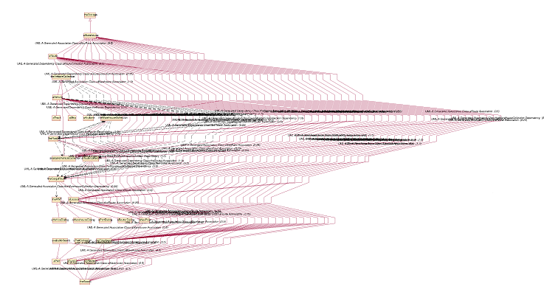
Implementation-Level View of an Application
Software Architecture: Foundations, Theory, and Practice; Richard N. Taylor, Nenad Medvidovic, and Eric M. Dashofy; © 2008 John Wiley & Sons, Inc. Reprinted with permission.

Slide 14
Deployment
A software system cannot fulfill its purpose until it is deployed
  Executable modules are physically placed on the hardware devices on which they are supposed to run
The deployment view of an architecture can be critical in assessing whether the system will be able to satisfy its requirements
Possible assessment dimensions
  Available memory
  Power consumption
  Required network bandwidth

Slide 15
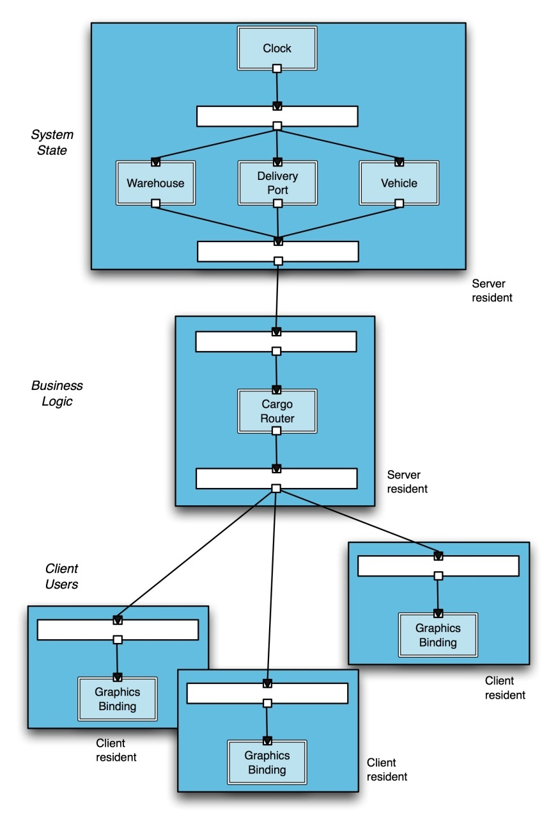
A System’s Deployment Architectural Perspective
Software Architecture: Foundations, Theory, and Practice; Richard N. Taylor, Nenad Medvidovic, and Eric M. Dashofy; © 2008 John Wiley & Sons, Inc. Reprinted with permission.

Slide 16
Software Architecture’s Elements
A software system’s architecture typically is not (and should not be) a uniform monolith
A software system’s architecture should be a composition and interplay of different elements
  Processing
  Data, also referred as information or state
  Interaction

Slide 17
Components
Elements that encapsulate processing and data in a system’s architecture are referred to as software components
Definition
  A software component is an architectural entity that
    encapsulates a subset of the system’s functionality and/or data
    restricts access to that subset via an explicitly defined interface
    has explicitly defined dependencies on its required execution context
Components typically provide application-specific services

Slide 18
Connectors
In complex systems interaction may become more important and challenging than the functionality of the individual components
Definition
  A software connector is an architectural building block tasked with effecting and regulating interactions among components
In many software systems connectors are usually simple procedure calls or shared data accesses
  Much more sophisticated and complex connectors are possible!
Connectors typically provide application-independent interaction facilities

Slide 19
Examples of Connectors
Procedure call connectors
Shared memory connectors
Message passing connectors
Streaming connectors
Distribution connectors
Wrapper/adaptor connectors

Slide 20
Configurations
Components and connectors are composed in a specific way in a given system’s architecture to accomplish that system’s objective
Definition
  An architectural configuration, or topology, is a set of specific associations between the components and connectors of a software system’s architecture

Slide 21
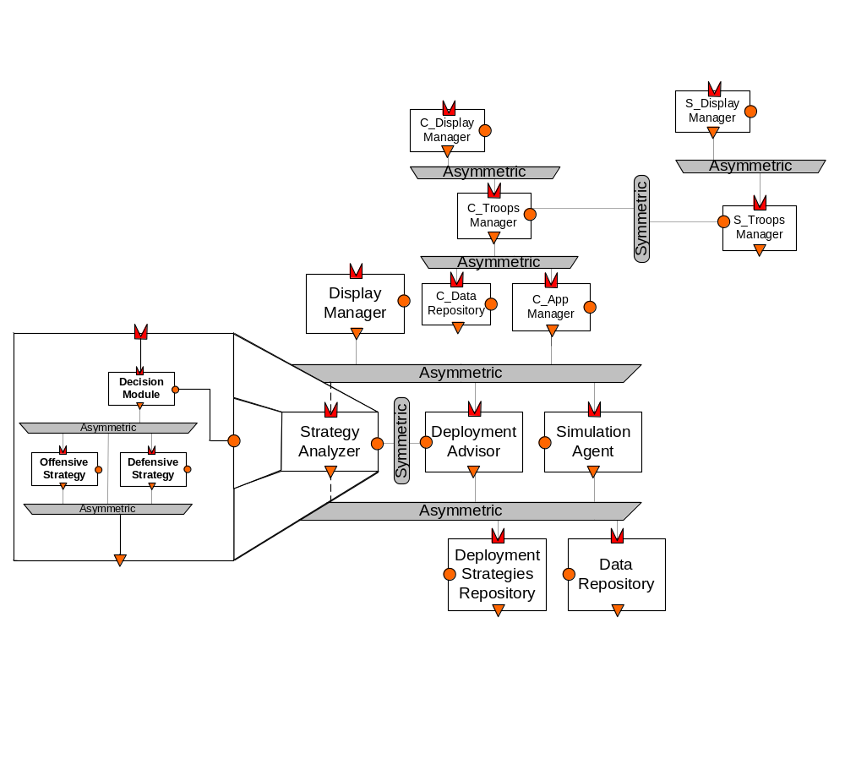
An Example Configuration
Software Architecture: Foundations, Theory, and Practice; Richard N. Taylor, Nenad Medvidovic, and Eric M. Dashofy; © 2008 John Wiley & Sons, Inc. Reprinted with permission.

Slide 22
Architectural Styles
Certain design choices regularly result in solutions with superior properties
  Compared to other possible alternatives, solutions such as this are more elegant, effective, efficient, dependable, evolvable, scalable, and so on
Definition
  An architectural style is a named collection of architectural design decisions that
    are applicable in a given development context
    constrain architectural design decisions that are specific to a particular system within that context
    elicit beneficial qualities in each resulting system

Slide 23
Architectural Patterns
Definition
  An architectural pattern is a set of architectural design decisions that are applicable to a recurring design problem, and parameterized to account for different software development contexts in which that problem appears
A widely used pattern in modern distributed systems is the three-tiered system pattern
  Science
  Banking
  E-commerce
  Reservation systems

Slide 24
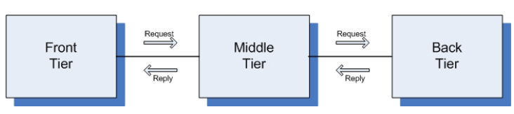
Three-Tiered Pattern
Front Tier
  Contains the user interface functionality to access the system’s services
Middle Tier
  Contains the application’s major functionality
Back Tier
  Contains the application’s data access and storage functionality
Software Architecture: Foundations, Theory, and Practice; Richard N. Taylor, Nenad Medvidovic, and Eric M. Dashofy; © 2008 John Wiley & Sons, Inc. Reprinted with permission.

Slide 25
Architectural Models, Views, and Visualizations
Architecture Model
  An artifact documenting some or all of the architectural design decisions about a system
Architecture Visualization
  A way of depicting some or all of the architectural design decisions about a system to a stakeholder
Architecture View
  A subset of related architectural design decisions

Slide 26
Architectural Processes
Architectural design
Architecture modeling and visualization
Architecture-driven system analysis
Architecture-driven system implementation
Architecture-driven system deployment, runtime redeployment, and mobility
Architecture-based design for non-functional properties, including security and trust
architectural adaptation

Slide 27
Stakeholders in a System’s Architecture
Architects
Developers
Testers
Managers
Customers
Users
Vendors

